Slide 1


Amazon Sales Analysis Report

Slide 2
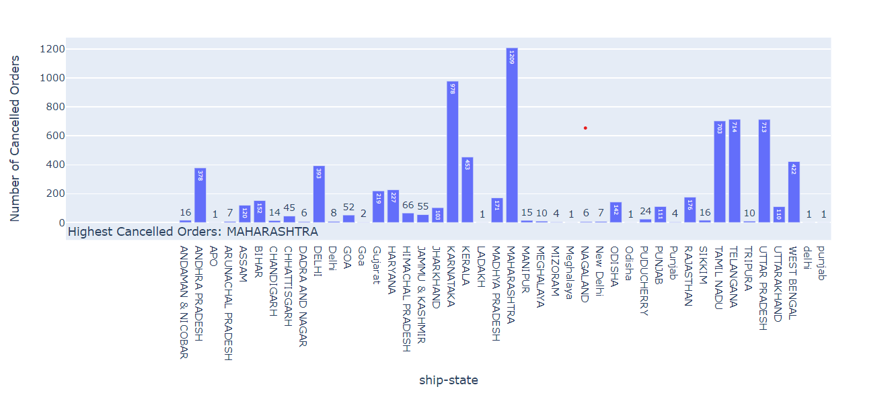
key findings
_01
Maharashtra and Karnataka have the highest number of orders, as well as the highest number of cancellations.

Slide 3
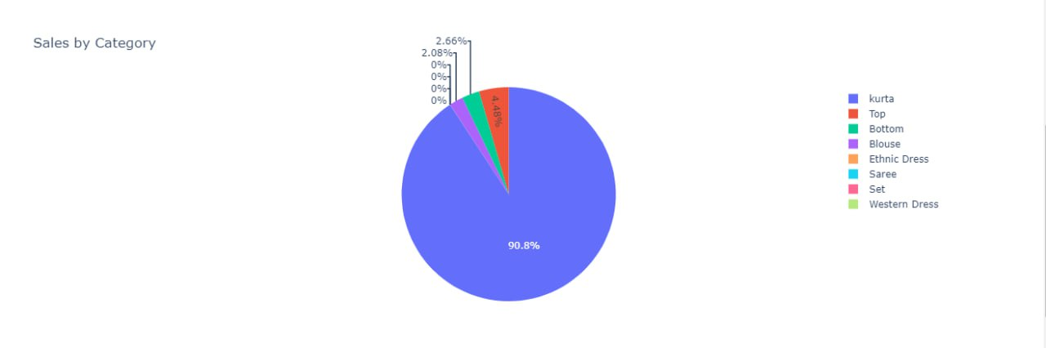
key findings
The Kurta category has the most orders.
_02

Slide 4
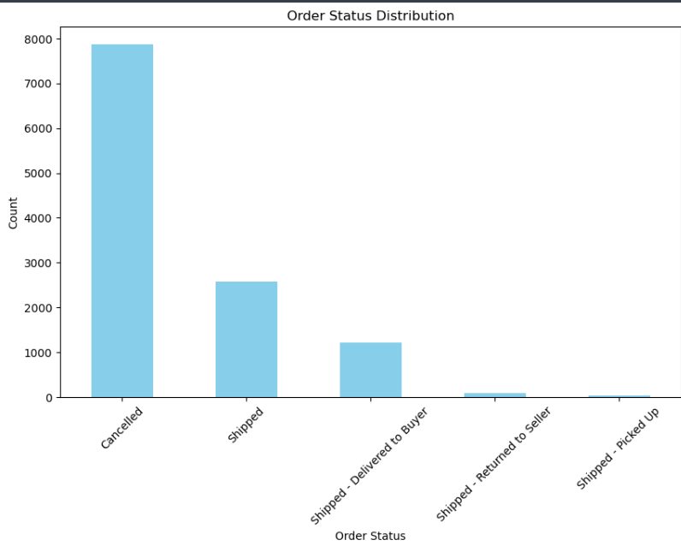
key findings
The number of cancelled orders exceeds the number of shipped orders.

Slide 5
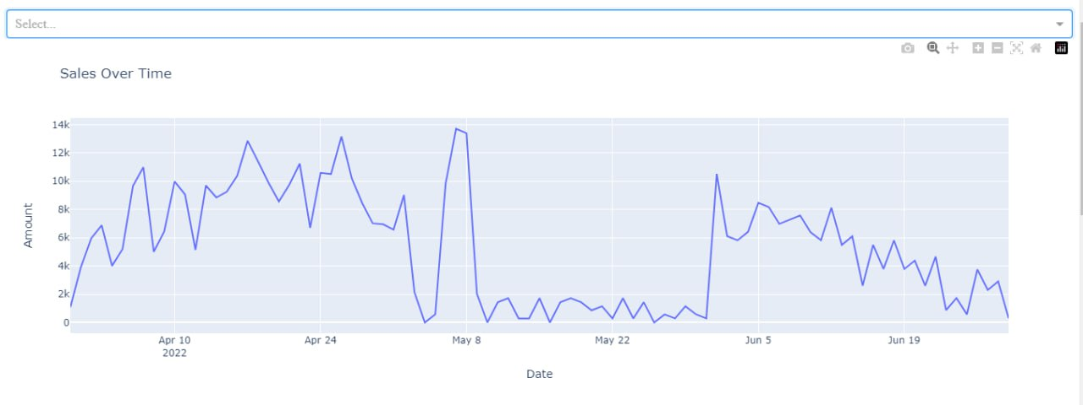
key findings
The highest revenue was recorded between April 10 and May 8, with the peak occurring on May 8.

Slide 6
02
Recommendations
Understand customer preferences by analyzing reviews and feedback so we can increase sales.
Enhance Product Listings by improve product descriptions with clear and concise information and also use high quality images and videos
Encourage customers to rate products so we can reduce the number of cancelled orders
Introduce new products based on market demand.
Diversify the product categories to cater to a wider audience.

Slide 7

Thank You!

